Slide 1
Document Exchange Platform User’s Manual January 2021

Slide 2
REGISTER NEW USER
To create a new account:
Press the Register New User button

Slide 3
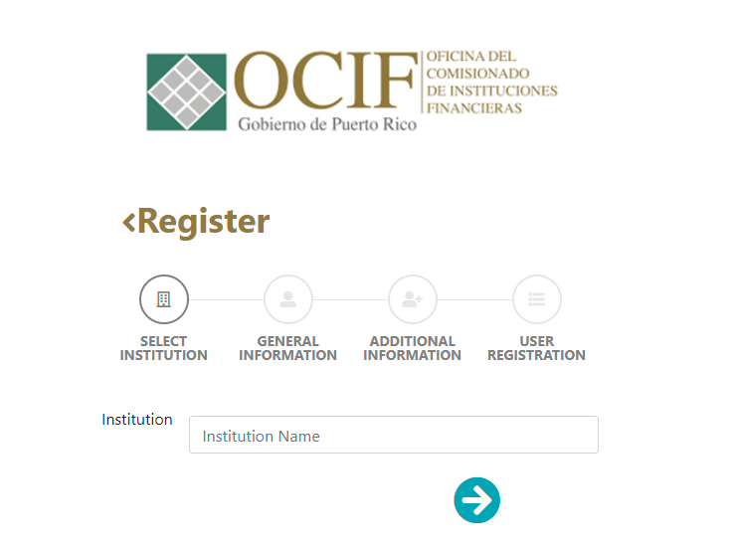
REGISTER NEW USER
To create a new account (Select Institution):
Select the financial institution from the menu
Press arrow below to CONTINUE

Slide 4
REGISTER NEW USER
To create a new account (General Information):
Enter a Username
Enter a Password
Confirm Password
Enter an Email address*
Press the arrow below signaling to the right to CONTINUE
*It is very important to enter the email address correctly given that you will be receiving a PIN number in that address to complete the registration process in the platform.

Slide 5
REGISTER NEW USER
To create a new account (Additional Information):
Enter your name in the Contact field
Enter your position within the financial institution in the Position field
Press the arrow below signaling to the right to CONTINUE

Slide 6
REGISTER NEW USER
To create a new account (User Registration):
Confirm the information entered is correct*
Confirm the CAPTCHA
Press the Register button
*If necessary, correct any errors by pressing the arrow below signaling to the left.

Slide 7
REGISTER NEW USER
A PIN number will be sent to the email address you provided.
Enter the PIN number in the first field
Enter the financial institution’s license number in the second field
Press Validate PIN to complete the registration*
*If an error message appears, review your entries and press Validate PIN again. If the information entered is correct, you will see a message indicating that the user has been created successfully.
The platform will redirect you to the homepage.

Slide 8
LOGIN
To sign into the platform:
Enter your credentials (username and password)
Confirm the CAPTCHA
Press LOGIN

Slide 9
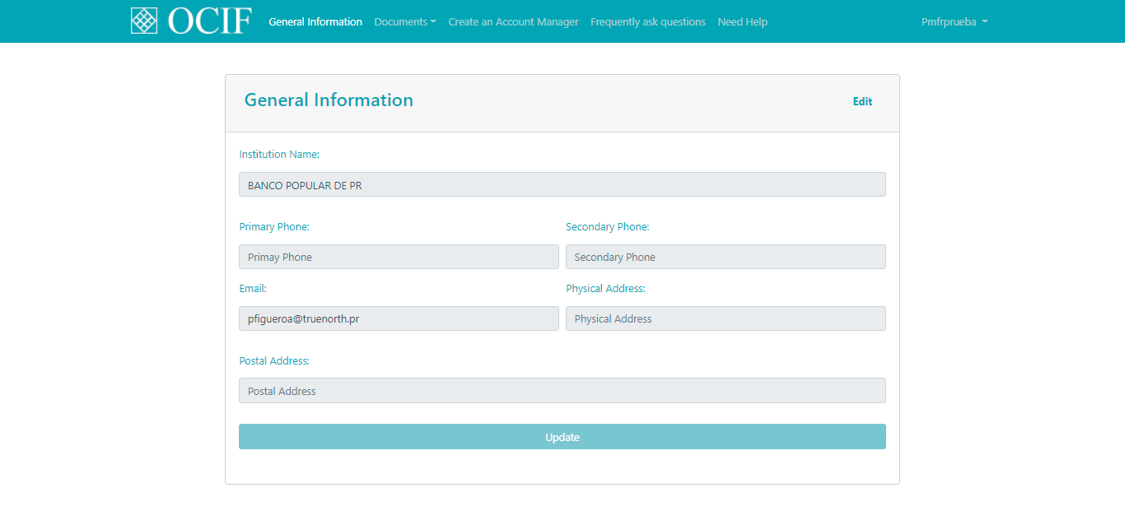
GENERAL INFORMATION
To edit the account’s general information:
Click on the General Information tab at the top of the page
Press the Edit button
Click on the field you want to edit and make the desired modifications
Press the Update button to save the information

Slide 10
DOCUMENTS: Document Management
To upload or search documents that have already been uploaded to the platform:
Click on the Documents tab’s drop-down menu
Select Document Management
The platform will go to the Document Management section.

Slide 11
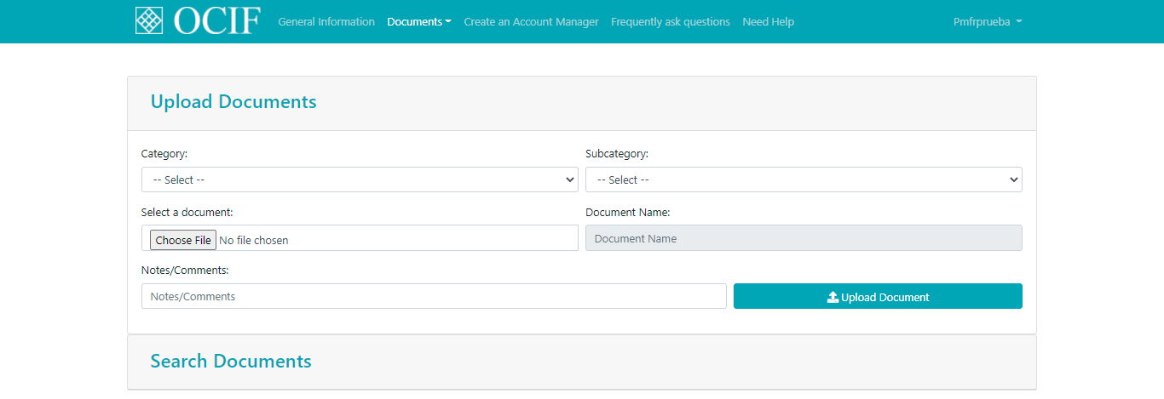
DOCUMENTS: Document Management (Upload)
To upload a document:
Press the Upload Documents accordion
Select the document category from the category menu
Select the document subcategory from the subcategory menu
Press the Choose File button
Select the document you want to upload
Enter any notes or comments related to the document that has been uploaded (optional)
Press the Upload Document button

Slide 12
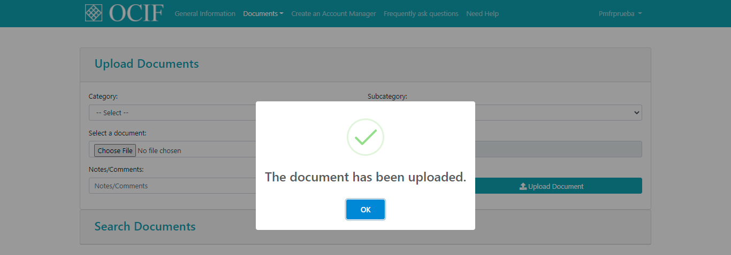
DOCUMENTS: Document Management
If the document is uploaded successfully, you will see a message that reads “The document has been uploaded.”
Press OK to return to the Document Management page.

Slide 13
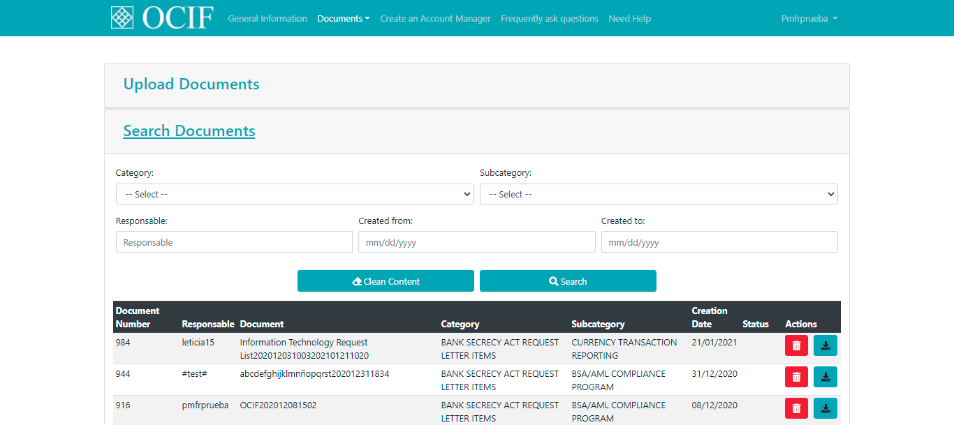
DOCUMENTS: Document Management (Search)
To search documents:
Press the Search Documents accordion
Search by documents’ category, subcategory, user responsible of uploaded document, and/or date.
Press the Search button to search documents within the selected criteria
Press the Clean Content button to carry out a new search.
The platform will bring all documents that fall into the selected criteria.

Slide 14
DOCUMENTS: Document Management (Search)
To delete a document:
Press the red button in the Actions column
Press OK
To download a document:
Press the blue button in the Actions column
Document will download automatically in PDF format

Slide 15
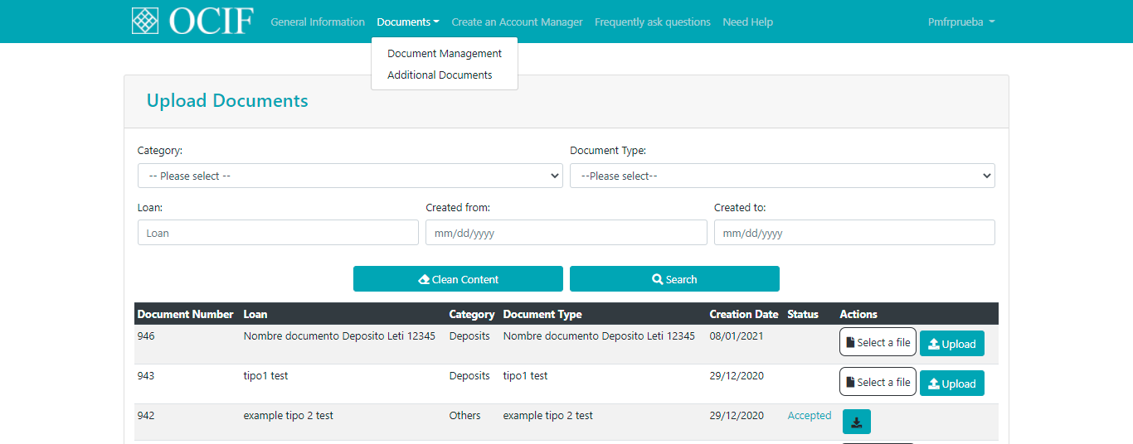
DOCUMENTS: Additional Documents
To carry out searches or upload additional documents required by the financial institution:
Click on the Documents tab’s drop-down menu
Select Additional Documents
To search documents in this section:
Search by document category, document type, loan name, and/or date
Press the Search button to search documents within the selected criteria
Press the Clean Content button to carry out a new search

Slide 16
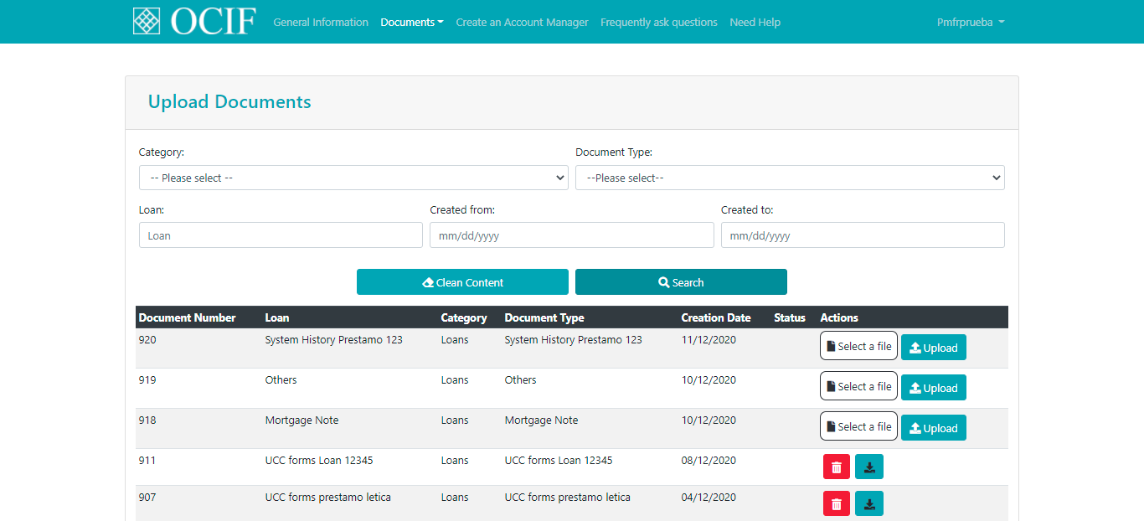
DOCUMENTS: Additional Documents
The documents that have already been uploaded will have the DELETE and DOWNLOAD buttons available in the Actions column. For the documents that have not yet been uploaded, you will see a Select a file/Upload button in the Actions column.
To upload a document in this section:
Press the Select a file button in its row
Select the file from your computer
Press the Upload button to upload it to the platform
Once the new document has been uploaded, the DELETE and DOWNLOAD buttons will be enabled in the Actions column.

Slide 17
CREATE AN ACCOUNT MANAGER
To create an Account Manager user:
Click on the Create an Account Manager tab at the top of the page
Enter a Username
Enter a Password
Confirm the Password
Enter an Email address
Press the Create Account button to create the new account manager user

Slide 18
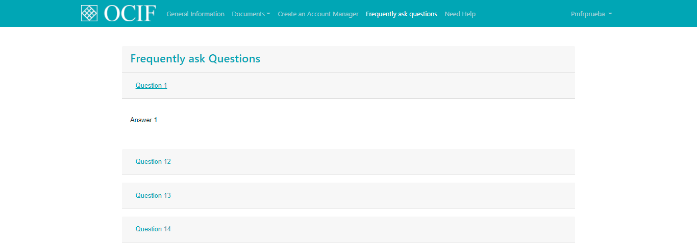
FREQUENTLY ASKED QUESTIONS
To access a list of frequently asked questions:
Click on the Frequently Asked Questions tab at the top of the page
Press each question’s accordion to reveal its answer

Slide 19
NEED HELP
To send a question:
Click on the Need Help tab at the top of the page
Select the reason of the message from the menu provided
Type your question in the Message box
Press the Send Question button

Slide 20
CHANGE PASSWORD
To change the account’s password:
Click on the Username tab
Select Change Password from the drop-down menu
Enter the Old Password
Enter the New Password
Confirm the new password by re-entering it in the Confirm Password field
Press the Change Password button
If there are no errors in the fields, you will see a message indicating that the password has been changed successfully. Press OK to return to the Documents section.

Slide 21
LOGOUT
To end the session:
Click on the Username tab
Select Logout from the drop-down menu
The session will be ended, and you will be redirected to the login page.

